Slide 1
Minimizing Dockerfiles
Thesis – 30th of June 2025
Andrei Petrea
scpetrea@gmail.com
Conf. Răzvan Deaconescu

Slide 2
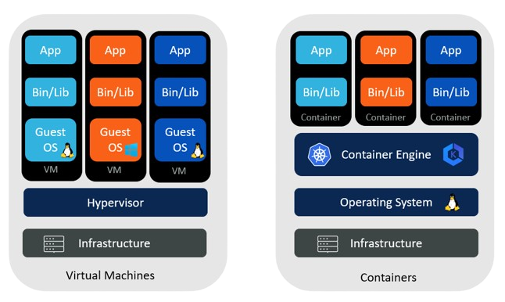
Introduction
Virtualization: The simulation of the software and/or hardware upon which other software runs.
Containerization: A method for packaging and securely running an application within an application virtualization environment (container)
VMs vs Containers ^{[1]}
2
Notes:
[1] Comparing VMs and Containers - Aqueduct Tech

Slide 3
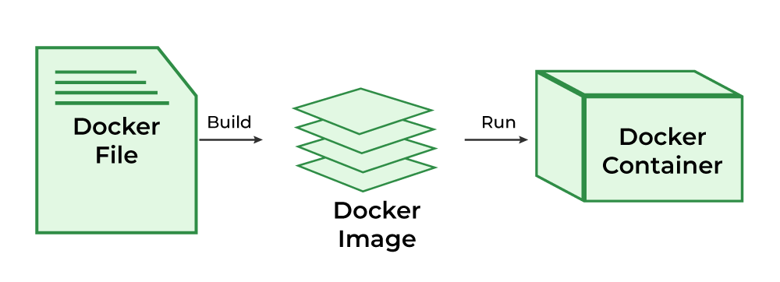
Containers
Steps to containerize an application from a Dockerfile ^{[2]}
Notes:
[2] What is Docker? - GeeksforGeeks

Slide 4
Dockerfile
FROM python:3.12
WORKDIR /usr/local/app
COPY requirements.txt ./
RUN pip install --no-cache-dir \
-r requirements.txt
COPY src ./src
EXPOSE 5000
RUN useradd app
USER app
CMD ["uvicorn", "app.main:app", "--host",
"0.0.0.0", "--port", "8080"]
Base image
Adding files to the container + metadata
Command to be run
4
Notes:
[1] Comparing VMs and Containers - Aqueduct Tech

Slide 5
Context
1. Problem
2. Industry solution
3. Building from scratch
• image size: 1.02 GB • based on a full Debian distro

Slide 6


Context
1. Problem
2. Industry solution
3. Building from scratch
• Slim Debian^{[3]}, Alpine Linux^{[4]}
• equivalent image for python, node,
java, etc
Notes:
[3] debian - Official Image | Docker Hub [4] alpine - Official Image | Docker Hub

Slide 7
Context
1. Problem
2. Industry solution
3. Building from scratch^{[5]}
Docker’s minimal image (no files)
each dependency has to be manually added
used mostly in multi-stage builds
Notes:
[5] scratch - Official Image | Docker Hub

Slide 8
Motivation
1. Efficient use of resources
2. Reduction of costs
3. Faster boot-time

Slide 9

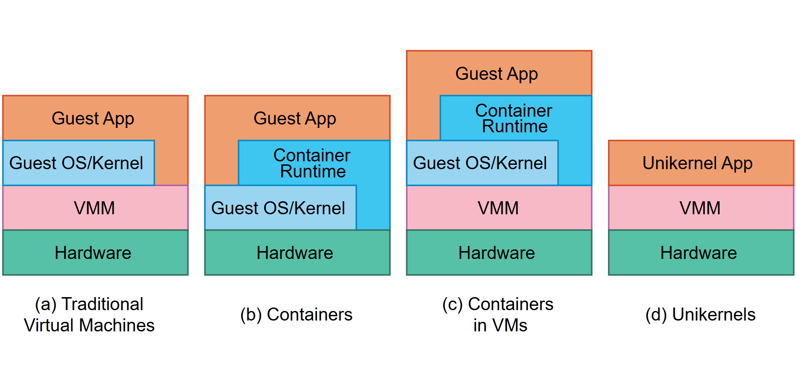
Use Case
High-level comparison of the software components of traditional VMs (a), containers (b), containers in VMs (c) with unikernels (d)^{[6]}
Notes:
[6] Concepts - Unikraft

Slide 10
Use Case
spec: v0.6
runtime: base:latest
rootfs: ./Dockerfile
cmd: ["/helloworld"]
minimal Dockerfile
Kraftfile for hello-world in C^{[7]}
Notes:
[7] catalog/examples/helloworld-c/Kraftfile at main · unikraft/catalog

Slide 11
How?
Determine the dependencies of the command
• Using ldd
linux-vdso.so.1 (0x00007ffd68d5f000)
libc.so.6 => /lib/x86_64-linux-gnu/libc.so.6 (0x00007f23ba6b0000)
libpthread.so.0 => /lib/x86_64-linux-gnu/libpthread.so.0 (0x00007f23ba68d000)
libdl.so.2 => /lib/x86_64-linux-gnu/libdl.so.2 (0x00007f23ba687000)
libutil.so.1 => /lib/x86_64-linux-gnu/libutil.so.1 (0x00007f23ba682000)
libm.so.6 => /lib/x86_64-linux-gnu/libm.so.6 (0x00007f23ba533000)
libexpat.so.1 => /lib/x86_64-linux-gnu/libexpat.so.1 (0x00007f23ba505000)
libz.so.1 => /lib/x86_64-linux-gnu/libz.so.1 (0x00007f23ba4e7000)
/lib64/ld-linux-x86-64.so.2 (0x00007f23ba8b5000)
ldd python3

Slide 12
How?
Determine the dependencies of the command
• Using ldd
• Using strace
open, exec
follow child processses
strace -fe execve,openat,open ls
execve("/usr/bin/ls", ["ls"], 0x7ffee0a0a390 /* 36 vars */) = 0
openat(AT_FDCWD, "/etc/ld.so.cache", O_RDONLY|O_CLOEXEC) = 3
openat(AT_FDCWD, "/lib/x86_64-linux-gnu/libselinux.so.1", O_RDONLY|O_CLOEXEC) = 3
openat(AT_FDCWD, "/lib/x86_64-linux-gnu/libc.so.6", O_RDONLY|O_CLOEXEC) = 3
openat(AT_FDCWD, "/lib/x86_64-linux-gnu/libpcre2-8.so.0", O_RDONLY|O_CLOEXEC) = 3
openat(AT_FDCWD, "/lib/x86_64-linux-gnu/libdl.so.2", O_RDONLY|O_CLOEXEC) = 3
openat(AT_FDCWD, "/lib/x86_64-linux-gnu/libpthread.so.0", O_RDONLY|O_CLOEXEC) = 3
openat(AT_FDCWD, "/proc/filesystems", O_RDONLY|O_CLOEXEC) = 3
openat(AT_FDCWD, "/usr/lib/locale/locale-archive", O_RDONLY|O_CLOEXEC) = 3
openat(AT_FDCWD, "/usr/share/locale/locale.alias", O_RDONLY|O_CLOEXEC) = 3

Slide 13
How?
Determine the dependencies of the command
• Using ldd
• Using strace • Trial and error
Adding and removing files until the command works

Slide 14

Implementation
High-level language with low-level support
Thriving ecosystem of modules and libraries
Directly interact with Docker (Docker SDK^{[8]})
Notes:
[8] client package - github.com/docker/docker/client - Go Packages

Slide 15
Flow
app.post("/", (req, res) => {
const url = req.body.url;
if (!url) {
return res.status(400).json({ error: "URL is required" });
}
if (!/^https?:\/\/.+/.test(url)) {
return res.status(400).json({ error: "Invalid URL format" });
}
if([...urls.values()].includes(url)) {
return res.json({ shortUrl: [...urls.entries()].find(([key, value]) => value === url)[0] });
}
while (true) {
const shortUrl = generateShortURL(6);
if (!urls.has(shortUrl)) {
urls.set(shortUrl, url);
return res.json({ shortUrl });
}
}
}); app.get("/:shortUrl", (req, res) => {
if (urls.has(req.params.shortUrl)) {
res.redirect(urls.get(req.params.shortUrl));
}
else {
res.status(404).json({ error: "URL not found" });
}
}); app.listen(port, hostname, () => {
console.log(`Server is running at http://${hostname}:${port}`);
});
URL shortener app

Slide 16
Example
FROM node:20.9.0
WORKDIR /app
COPY app.js /app/app.js
COPY package.json /app/package.json
COPY package-lock.json /app/package-lock.json
RUN npm install
EXPOSE 3000
CMD ["node", "app.js"]
Dockerfile for our application
Image size: 1.1 GB

Slide 17
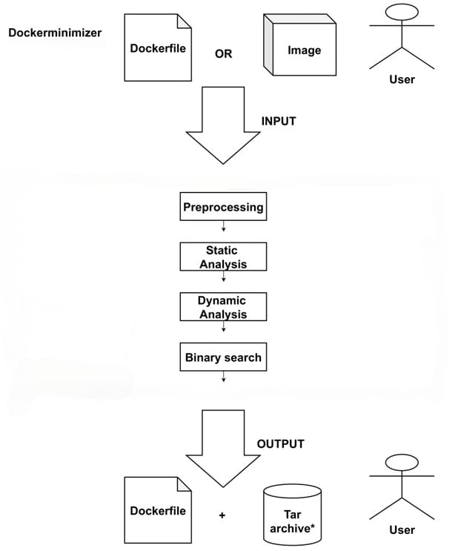
Flow
• User runs the program with the specified arguments
• --file: The path to the Dockerfile to be minimized • --image: The name of an image from a Docker registry to be minimized
• --max_limit: How many times the binary search procedure should be run
• --debug: Enable logging of actions
• --timeout: How long the minimal Docker container should run before being declared successful
• --strace_path: The path to a statically linked strace binary
• --binary_search: Whether to continue the minimization with binary search if dynamic analysis failed

Slide 18

Flow
Validate Dockerfile/ Container image
Create environment + extract filesystem
Generate a template Dockerfile
Environment Variables
- PATH=/usr/local/sbin:/usr/local/bin:/usr/sbin:/usr/bin:/sbin:/bin
- NODE_VERSION=20.9.0
- YARN_VERSION=1.22.19
Working directory: /app
Ports : 3000/tcp
Entrypoint : ["docker-entrypoint.sh"]
Command: ["node", "app.js"]

Slide 19
Flow
Find the image’s application to analyze
entrypoint + command
docker-entrypoint.sh node app.js
Run ldd and parse the output
Generate minimal Dockerfile candidate
Skips static analysis, continues with dynamic analysis

Slide 20
Flow
Mount the strace and logfile to a container tracing the app
Trace open,openat,execve,execveat syscalls
Check for shebang
(/bin/sh)
Re-run static analysis + dynamic analysis for /bin/sh
Generate minimal Dockerfile candidate
analysis successful

Slide 21
Flow
0. Load extracted filesystem into a tree structure
1. Split the tree in half – used and unused
2. Create a tar archive of used files
3. Generate minimal Dockerfile candidate
4. If not ok, check if there are unused files left and if there are, go to step 1, else throw error
5. If ok, exit
6. Repeat steps 1-5 max_limit times

Slide 22
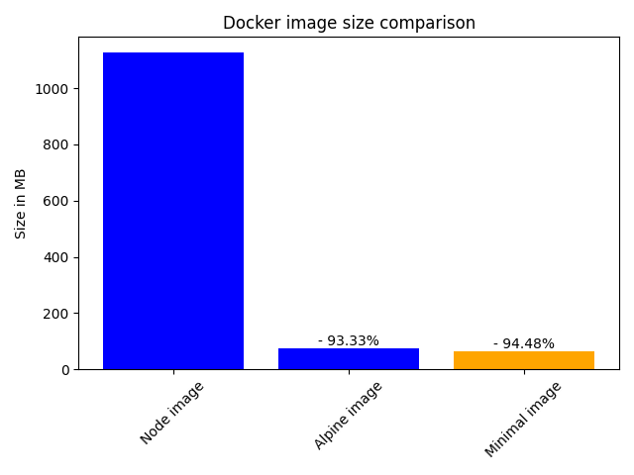
Result
minimal Dockerfile
105 build stages
62.3 MB

Slide 23
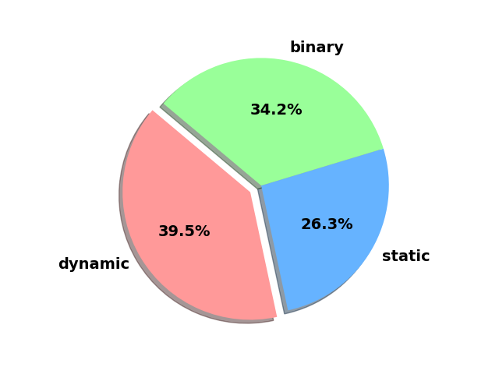
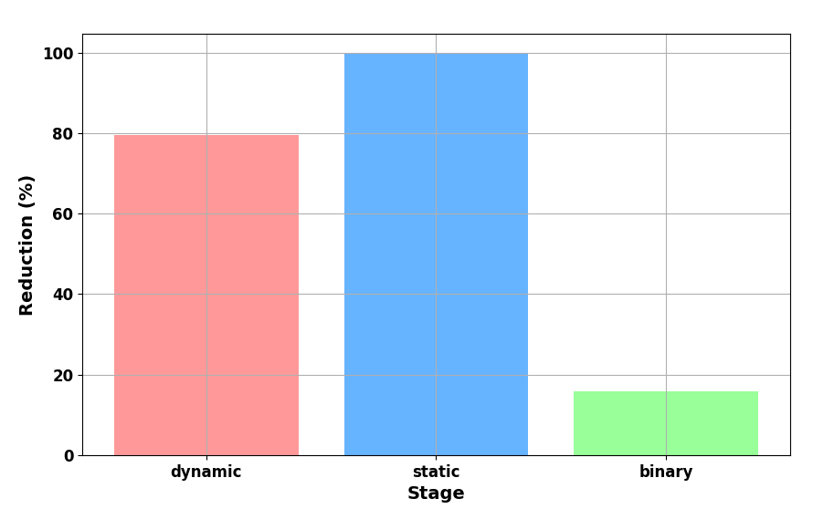
Performance Evaluation
Echelon of 38 application, from hello worlds to dbs and web servers
Distribution of apps by the stage where minimization succeded
Average reduction per stage

Slide 24
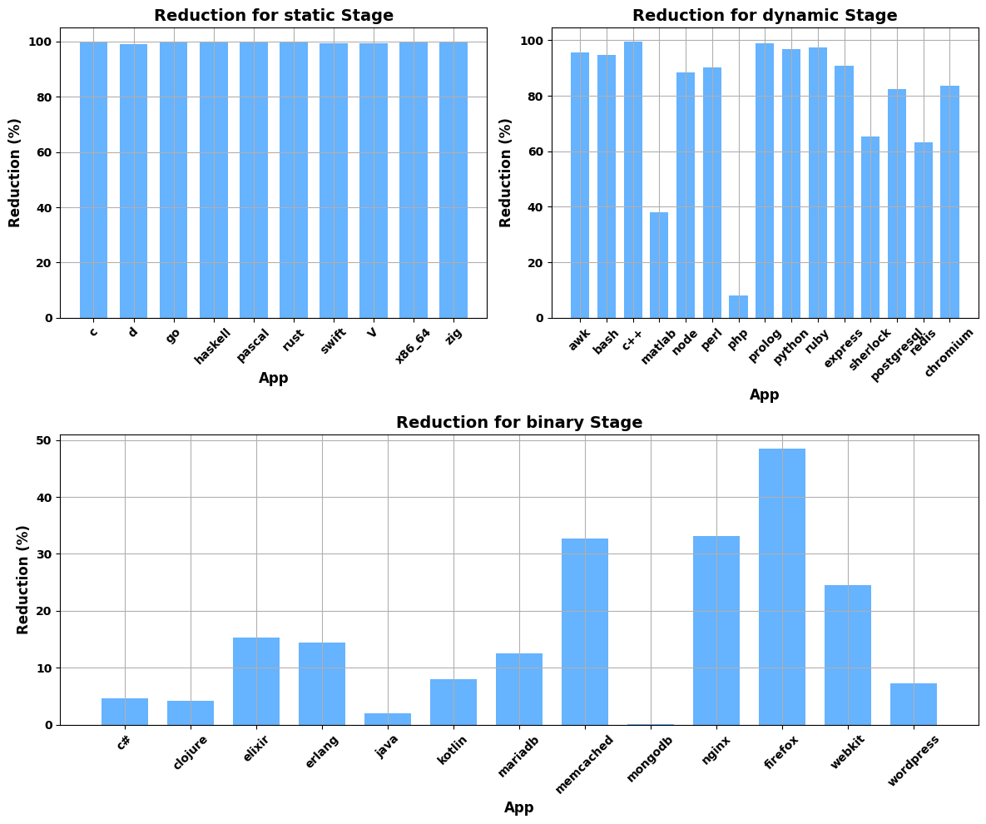
Performance Evaluation

Slide 25
Conclusions and Future Work
ROADMAP
June
Add different tracing methods for dynamic analysis (eBPF, ftrace, etc)
Improve the binary search by using a heuristic algorithm to split the filesystem
Improve the performance of the binary search
Add a GUI to the app
Add support for different container creation files

